Slide 1
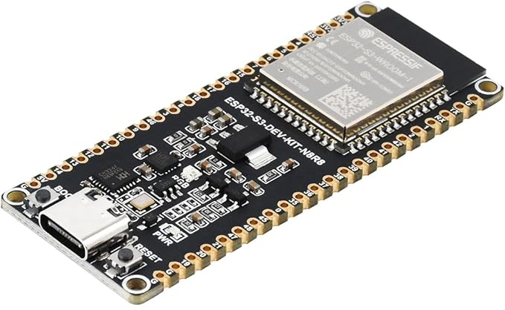
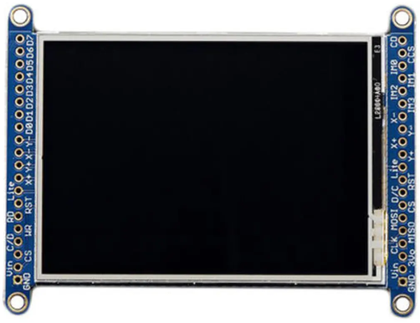
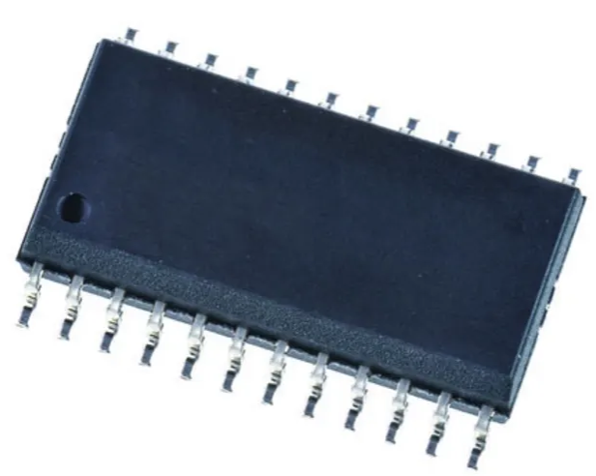
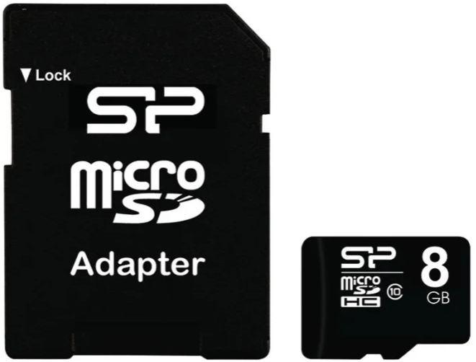
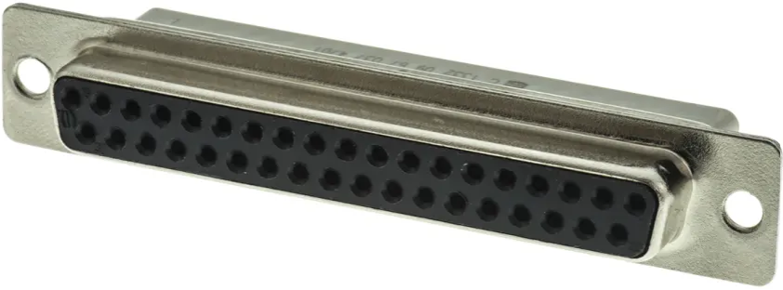
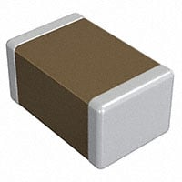
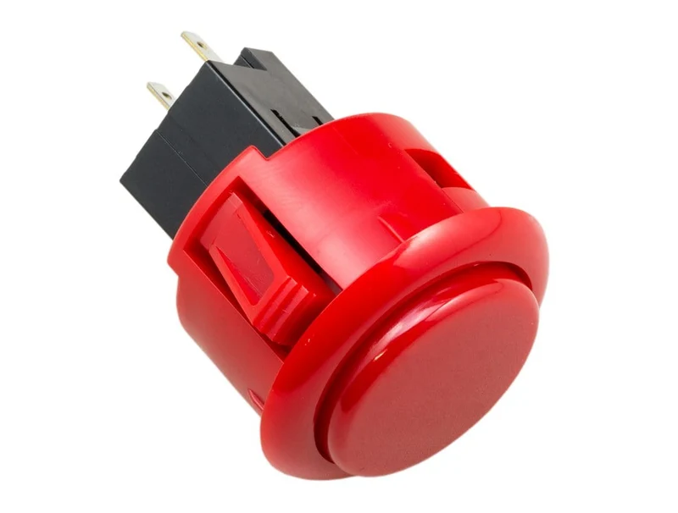
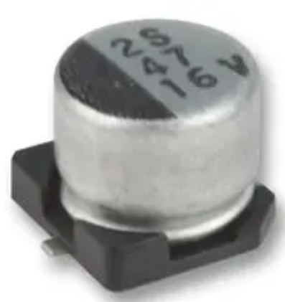
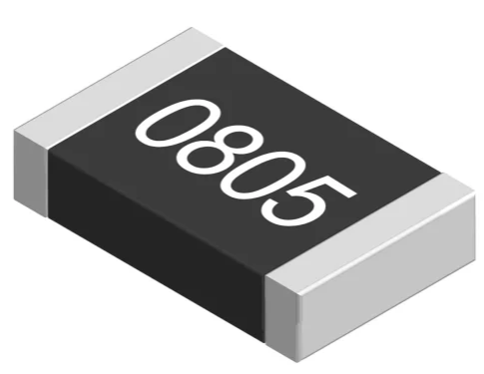
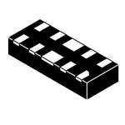
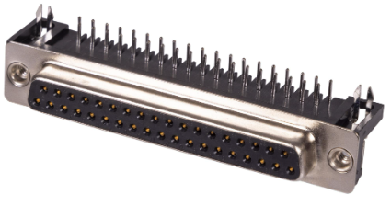
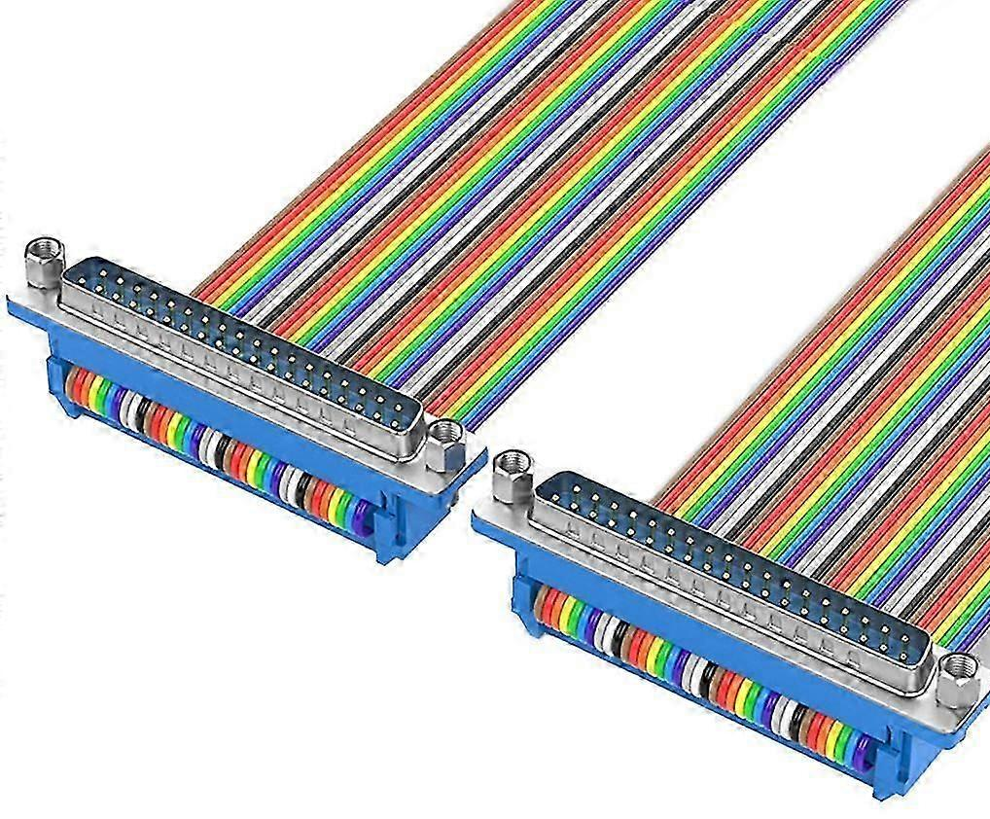
Description | Part Number | Quantity | Supplier URL | ID | Image | Cost (£)
32 Bit Microcontroller | ESP32-S3-DEVKITC-1U-N8R8 | 1 | https://www.amazon.co.uk/Waveshare-Development-ESP32-S3-WROOM-1-Processor-Connector/dp/B0DLWGVXCS | ESP32-S3-DEV-KIT-16MB |  | 15.35
2.8 LCD Display Module With MicroSD Socket | 1770 | 1 | https://uk.rs-online.com/web/p/display-development-tools/1245469 | ILI9341 |  | 23.13
16:1 multiplexer | CD74HC4067M96 | 8 | https://uk.rs-online.com/web/p/multiplexer-demultiplexer-ics/6622577 | CD74HC4067M96 |  | 4.21
Micro SD card | SP008GBSTH010V10SP | 1 | https://uk.rs-online.com/web/p/sd-cards/2883799 | 8 GB MicroSDHC microSD, Class 10 |  | 9.24
F/F 37-way D-Sub coupler | 09670374701 | 4 | https://uk.rs-online.com/web/p/d-sub-connectors/1007822 | HARTING D-Sub 37 Way Straight Cable D-Sub Connector |  | 8.44
0.1uF Decoupling capacitor | GCM155R71H104KE02J | 10 | https://www.digikey.co.uk/en/products/detail/murata-electronics/GCM155R71H104KE02J/4903705 | 0.1 µF ±10% 50V Ceramic Capacitor X7R 0402 |  | 0.26
Snap-in arcade button | OBSF-30RG | 1 | https://thepihut.com/products/official-sanwa-arcade-button-long-life | Sanwa Round 30mm Long Life Snap-in Arcade Button |  | 4.90
10uF Electrolytic capacitor | MCESL16V106M4X5.2 | 9 | https://uk.farnell.com/multicomp-pro/mcesl16v106m4x5-2/cap-10-f-16v-radial-smd/dp/9265686 | SMD Aluminium Electrolytic Capacitor, Radial Can - SMD, 10 µF |  | 1.68
10k Resistor | RT0805FRE0710KL | 8 | https://uk.rs-online.com/web/p/surface-mount-resistors/1985686 | Yageo RT 10 kΩ, 0805 Thin Film Surface Mount Resistor |  | 0.24
TVS Diode | ESDR0524SMUTAG | 32 | https://www.mouser.co.uk/en/ProductDetail/onsemi/ESDR0524SMUTAG | ESD Protection Diodes / TVS Diodes 4 CHAN LOW CAP ESD PROT |  | 10.66
37 pin Female D-Sub mount connector | 5504F1-37S-02-03-F1 | 4 | https://cpc.farnell.com/multicomp-pro/5504f1-37s-02-03-f1/socket-d-pcb-r-a-37-way/dp/CN11147 | 37 Pin D-Sub Right Angle PCB Socket with Boardlock |  | 3.20
M/M 37 wire D-Sub cable | 9482490105136 | 4 | https://www.fruugo.co.uk/high-speed-data-transfer-cord-db37-data-cable-wire-d-sub-37pin-connectors-line/p-352918890-768284818 | DB37 Crimped Ribbon Data Cable |  | 23.80

